Slide 1


R
IMPACT
X
Brought to you by
CommonHealth
and the
Office of Workforce Engagement

Slide 2

Table of Contents
Important Terms and Definitions
Impacts of RX Overview and Pre-exposure
Youth Exposure
Adults and Workplace and Older Populations
Mental Health
Talking to your physician
Talking to your physician
Genetics
Dangers of Prescription Opioids
Risk factors of misuse and Tips to reduce addiction
Long and short-term side effects
Alternative treatments options
Identifying abuse
Tapering
Proper disposal
Flushable medications
Non Flushable medications
Collection sites
Additional considerations
Notes
References

Slide 3
Important Terms and Definitions
Opioid – Refers broadly to a class of chemicals that inhibit pain receptors in the brain, spinal cord, and digestive tract that function to reduce the effects of pain. (SOPHE.org, 2017)
Addiction – Characterized by a powerful, compulsive urge to use opioid drugs, even when they are no longer required medically. Opioids have a high potential for causing addiction in some people, even when the medications are prescribed appropriately and taken as directed. (NIH.gov)
Dependence – When an individual stops taking the drug, they experience physical and psychological symptoms of withdrawal, such as muscle cramping, diarrhea, and anxiety. (NIH.gov)
Misuse – Using more than prescribed, using more frequently, beginning to mix prescriptions with other substances for an increased effect, or taking medications for alternatives to pain (sedation, mood improvement, enjoyment). (PBS.org)
Opioid Use Disorder (OUD) – A strong desire for opioids, inability to control or reduce use regardless of normal life obligations (work, family, money, friends), and experiencing withdrawal when stopping or reducing use. (SOPHE.org, 2019)
*Dependence is not the same thing as addiction. Although everyone who takes opioids for an extended period will become dependent, only a small percentage also experience the compulsive, continuing need for the drug that characterizes addiction. (NIH.gov)

Slide 4
Impacts of Rx, Overview
In 2016, more than 20,000 deaths in the United States were caused by an overdose of prescription opioids, and another 13,000 deaths resulted from heroin overdose. Drug overdoses are now the leading cause of death in U.S. adults under age 50, and opioids account for more than half of all drug overdose deaths.
Taking opioids over a long period of time produces dependence, such that when people stop taking the drug, they have physical and psychological symptoms of withdrawal (such as muscle cramping, diarrhea, and anxiety).
Pre-exposure
Pre-exposure to opioids for some may be an unavoidable process as we all will more than likely experience some form of injury or pain, especially as we begin to age and experience wear and tear on the body. Surgeries, illnesses, arthritis, etc. are likely to be things that we will experience throughout our lifetime. However, it does not mean that one must fall victim to the epidemic of opioid abuse.
Pre-exposure use of opioids has been linked to several predispositions, along with the mismanagement or misunderstanding of the effects that opioids have on adolescents and adults.
Opioids are becoming the new “gateway drug”. People that report abusing opioids say that their first exposure was a prescription before using heroin (Mendonza & Russell, 2019).

Slide 5

Youth Exposure
There is a significant correlation with the biology of addiction. Babies that are pre-exposed in-utero are more likely to find their way back to opioid use due to the connection and dependency made during conception and throughout pregnancy.
As it pertains to pre-exposure, it is important to note adolescents are more likely to be exposed to opiates due to a variety of procedures and injuries that are more common occurrences in adolescents, such as: wisdom teeth extraction, sports injuries, and other injuries. Opioid exposure can also occur when teens have access to medicine cabinets of family or friends who have had pain management medications.
Opioid use, even legitimate exposure from a prescription at a young age, is associated with risk of long term use and possible misuse as an adult. (Miech, Johnston, O’Malley, Keyes, & Heard, 2015). Opioid use in youths prior to high school graduation is independently associated with a 33% increased risk of opioid misuse as an adult. (Meich, Johnston, O’Malley, Keyes, & Heard, 2015). McCabe, Teeter, and Boyd found in a study consisting of 9,000 college students with medical prescriptions for stimulants reported having been approached to sell or give their drugs to students without prescriptions (McCabe, Teter, & Boyd, 2006).

Slide 6
Adults and Workplace Exposure
Our work lives often have an effect on our home lives, and that can go the other way as well. It is important to focus on both home and work environments.
Nearly 15% of U.S. adults experience some form of chronic pain (Mendonza & Russell, 2019). Chronic pain is described as pain lasting three months past the normal time of healing (Mendonza & Russell, 2019). In a study conducted by the Workers Compensation Research Institute, they report that in 25 states, 65% to 85% of injured workers received narcotic pain killers as a pain management plan (Wesch p. 266).
Prescription medication misuse or abuse has been a hot topic in health care and among workforce leaders, as it affects the workforce in a multitude of ways: increased absenteeism, turnover, impaired job performance/increased accident rates, and increased health care costs (Goplerud, Hodge, & Benham, 2017). The CDC reports that the workforce loses $193 billion per year due to illicit drug use, which includes opioids (cdc.gov). There is also a physiological effect on employees that abuse prescriptions. Many experience depression, distress, and feelings of hopelessness (Goplerud, Hodge, & Benham, 2017).
Older Populations Exposure
Older adults are frequently prescribed opioids for their chronic pain (Chand et al., 2014). Over 80% of adults age 57-85 use at least one prescription medication (NIH.gov). The elderly are more sensitive to medications as their body may not clear the medication from their system as fast, causing doses to overlap and build up in their system (Chang et al., 2014).
In 2012, 2.9 million Americans age 50 or older reported nonmedical use of prescription drugs. This number is expected to increase drastically as the baby boomer generation ages and more patients are being treated for chronic pain (Chang et al., 2014). As the baby boomer population ages, there is an expected increase in opioid use of up to 70% (Levi-Minzi, Surratt, Kurtz, & Buttram, 2013).
Older adults are also more likely to turn to substance abuse due to the loss of family members or friends (Chang et al., 2014).

Slide 7
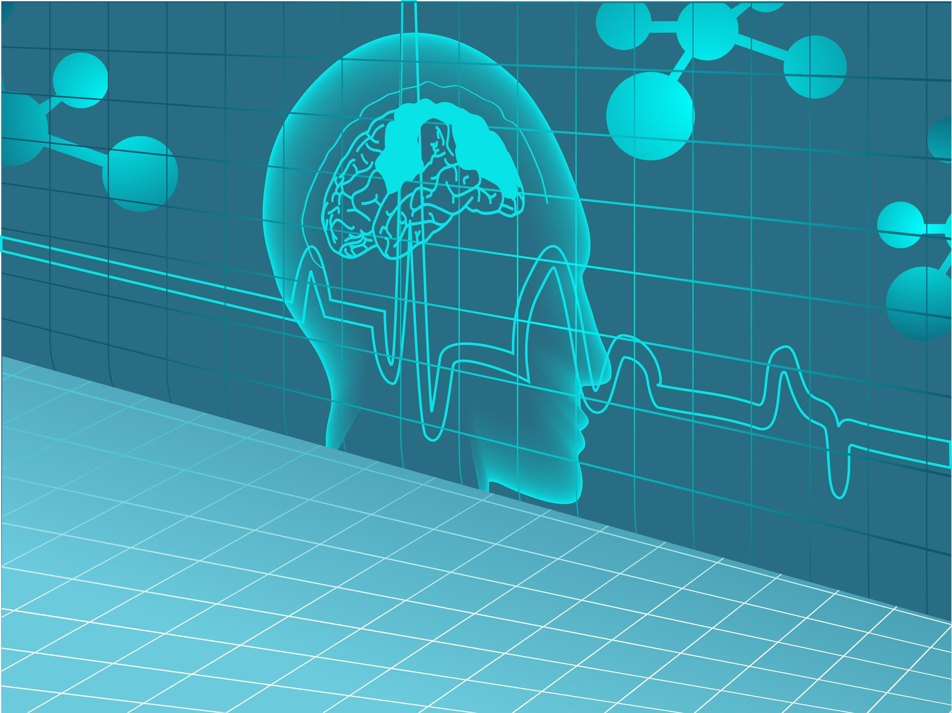
Mental Illness (National Institute on Drug Abuse, 2019)
DSM-5 defines OUD (Opioid Use Disorder) as a problematic pattern of opioid use leading to clinically significant impairment or distress (cdc.gov).
Some people may develop mental illnesses due to their compulsive drug use.
Some people may abuse medications to alleviate symptoms of existing mental illness.
Drug are highly abused among people suffering from (not an all inclusive list):
  Anxiety disorder
  PTSD
  Panic disorders
  Depression
  Bi-polar disorder
  Schizophrenia

Slide 8

Talking to Your Physician
It is important for every patient to ask questions when getting a new prescription. This is especially important when your medical provider, dentist, or other health care professional prescribes you an opioid, such as hydrocodone, oxycodone, codeine, and morphine. It’s very common for patients to simply accept the recommendations of a doctor. Most of us aren’t well versed in talking with our health care providers about pain management. A person taking prescription opioids for any length of time should ask about opioid safety, even if it’s just for a few days after a dental procedure.
When used properly as prescribed, opioids can provide much needed relief during the healing and recovery process. But abuse or uninformed use of opioid medications can lead to addiction and have devastating effects. It’s important to ask questions about both pain management options, as well as risks of opioid addiction. We know certain additional risk factors - genetics, family history, trauma, mental health, history of substance abuse, psychological / social stressors – can increase risk of addiction. Providers should be made aware of these factors when considering medication options with patients.

Slide 9

Time with my doctor is so limited, how do I best ensure that we consider alternative options, which might not be covered by insurance?
In 2016, the Centers for Disease Control created the first national guidelines for prescribing opioids for chronic pain. A key recommendation encouraged doctors to use non-opioid approaches to treat most pain. Advocate for increased communication with your provider and coverage options with your insurance company. You can also do research on your own to identify other options and then schedule a time to review these findings with your physician.
Questions for Your Physician
Can an opioid emergency or addiction still occur even if I take my prescription opioid as directed?
Could this medication interact negatively with other medications I currently take?
How long should I expect to be on these pain medications?
What side effects should I be aware of and how can I reduce the risk of potentially developing them?
What other medications should be part of the pain management program?
Is an opioid the only option I have to reduce pain? If not, what are the alternative options?
Does everyone have withdrawal symptoms when stopping medication?
What if opioids are not handling my pain?

Slide 10

Genetics and Addiction
There are many factors involved in how someone responds to medications like opioids and possibly becoming addicted. Some of these factors are related to lifestyle, environment, and genetics. There are many genes that play a role in opioid addiction (NIH.gov). Addictive behaviors are influenced by the body’s internal system for regulating pain and reward (NIH.gov). Addiction research is still in the early stages of being understood (Davis p. 38). The Corticolimbic, or limbic, system is where dopamine is released and gives us that “feel good” sensation (Davis p. 38). This part of the brain is also where we house learned memories, like when we smell something and it triggers a memory without even thinking about it. These “learned memories” are also called triggers when examining the effects of addiction. In short, the pathway to addiction is (Davis p. 41):
begin a prescription.
become desensitized to the medication.
build a tolerance (may need more to achieve the same effect).
become dependent (if medication is not taken, withdrawal will be experienced).
One important takeaway is that there is an “unknown” risk to starting a new medication that is known to be addictive. As we have learned, our genetics play a role in this and a plan should be developed with your physician, including frequent communication about concerns and a tapering plan if the medication will be taken for an extended period of time.

Slide 11
While opioids can be an important part of treatment, they also come with serious risks. That is why it is important to work with your doctor to make sure that you are getting the safest, most effective care. A simple conversation with your doctor can help prevent opioid addiction and overdose.
The Dangers of Prescription (Rx) Opioids
Opioids can be dangerous, and anyone can become addicted. Studies have shown that even just three days of opioid treatment can increase the likelihood of chronic opioid use. It only takes a little to lose a lot. Risks include misuse, abuse, opioid use disorder (addiction), and overdose.
Opioids affect the part of the brain that controls breathing. If you take a dosage that is too high, it can slow your breathing and cause death.
Combining opioids with alcohol or certain other drugs – like benzodiazepines (Xanax or Valium), sleep aids, muscle relaxants, hypnotics (Ambien or Lunesta), and other prescription opioids – increases your risk of overdose and death.
Some patients may experience negative side effects like the ones listed below, even when they take their opioid medication as directed:
Tolerance – meaning you might need to take more of a medication for the same pain relief
Physical dependence – meaning you have symptoms of withdrawal when a medication is stopped
Increased sensitivity to pain
Nausea, vomiting, and dry mouth
Confusion
Sleepiness and dizziness
Depression
Itching and sweating

Slide 12
Risk Factors for Opioid Misuse
Concerted research efforts have been devoted to identifying individuals at risk for misuse of prescription opioids. These include:
Family history of substance use disorder
Personal history of substance use disorder
Younger age
History of criminal activity and/or legal problems including DUIs
Regular contact with risky environments or situations (e.g.,
exposure to other people misusing opioids)
Interpersonal problems with past employers, family members, and friends
Risk taking or thrill-seeking behavior
Heavy tobacco use
History of severe depression or anxiety
Psychosocial stressors
Tips to Reduce the Risk of Prescription (Rx) Opioid Addiction
Do not share medication with others. Only take prescription medication that is prescribed to you.
Take medication as directed by your doctor. Never take opioids in greater amounts or more often than prescribed.
Keep medicines in a safe and secure place. It is best to store opioids in a place that is locked, like a keyed medicine cabinet or drawer, to keep them secure from children, family, friends, and visitors.
Properly discard expired or unused prescription opioids. Remove them from your home as soon as possible to reduce the chances of misuse. To get rid of prescription opioids and other medications safely, refer to the information included on pages 18-20.
Find a medicine take-back option near you: TakeBackDay.DEA.gov
Check with your pharmacist to see if you can return unused medication to the pharmacy for disposal.

Slide 13
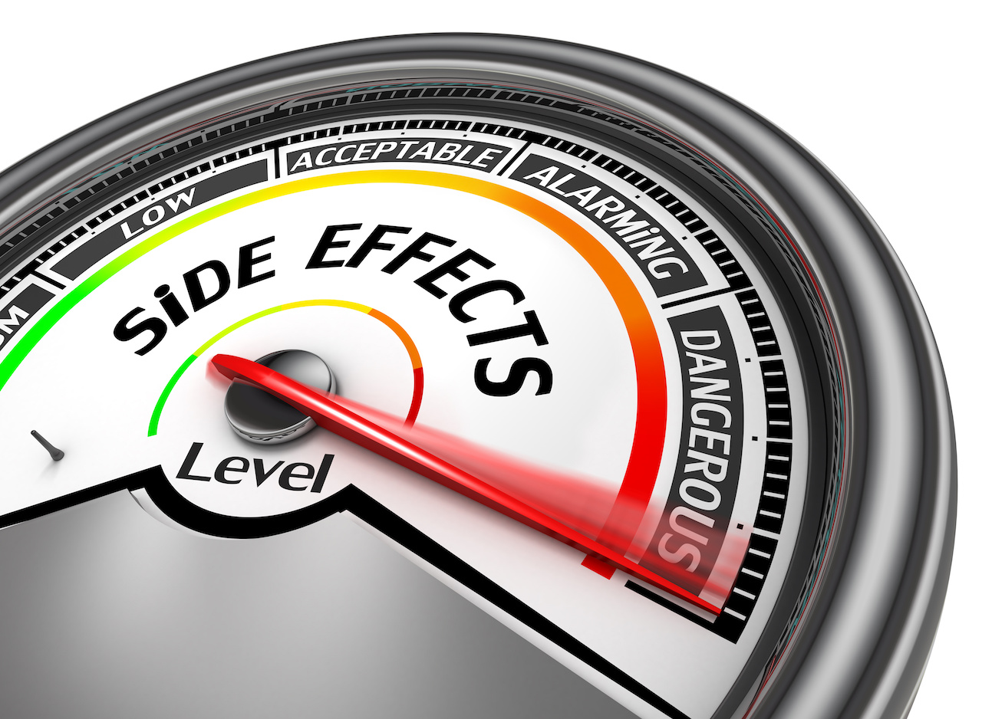
Long- and Short-Term Side Effects
There is roughly a 21% to 29% demographic of people who are prescribed opioids, but misuse them. Of that group, about 5% become opioid addicted and begin to search out other opioids as they require more medication or are refused prescription refills. There are short-term and long-term effects of opioids on the body.
Short-term effects of opioids and morphine derivatives include: drowsiness, slowed breathing, constipation, unconsciousness, nausea, and coma. The physical signs are ones that we are able to see almost immediately, such as mood swings, drowsiness, and confusion.
Long-term effects include: Continued use or abuse of opioids can result in physical dependence and addiction. The body adapts to the presence of the drug and withdrawal symptoms occur if use is reduced or stopped. Withdrawal symptoms include restlessness, muscle and bone pain, insomnia, diarrhea, vomiting, and cold flashes with goosebumps (“cold turkey”). Tolerance can also occur, meaning that long term users must increase their doses to achieve the same high.

Slide 14

There are many beneficial alternative treatment approaches that you and your health care provider can explore which include:
Physical therapy with exercises.
In some cases, over-the-counter options like Acetaminophen (the active ingredient in Tylenol), when used with Ibuprofen (the active ingredient in Advil), has been found to work just as well as opioids for reducing severe pain, according to a study published by JAMA. Patients should consult with their providers about the safe amounts to take of each medicine and confirm that they are good candidates for combining Acetaminophen and Ibuprofen.
Mindfulness-based strategies involving yoga and meditation.
Therapy and other behavioral approaches that address conditions like depression and anxiety, because untreated mental illnesses can worsen pain.
You may be able to reduce pain with out medication. What are you options?

Slide 15
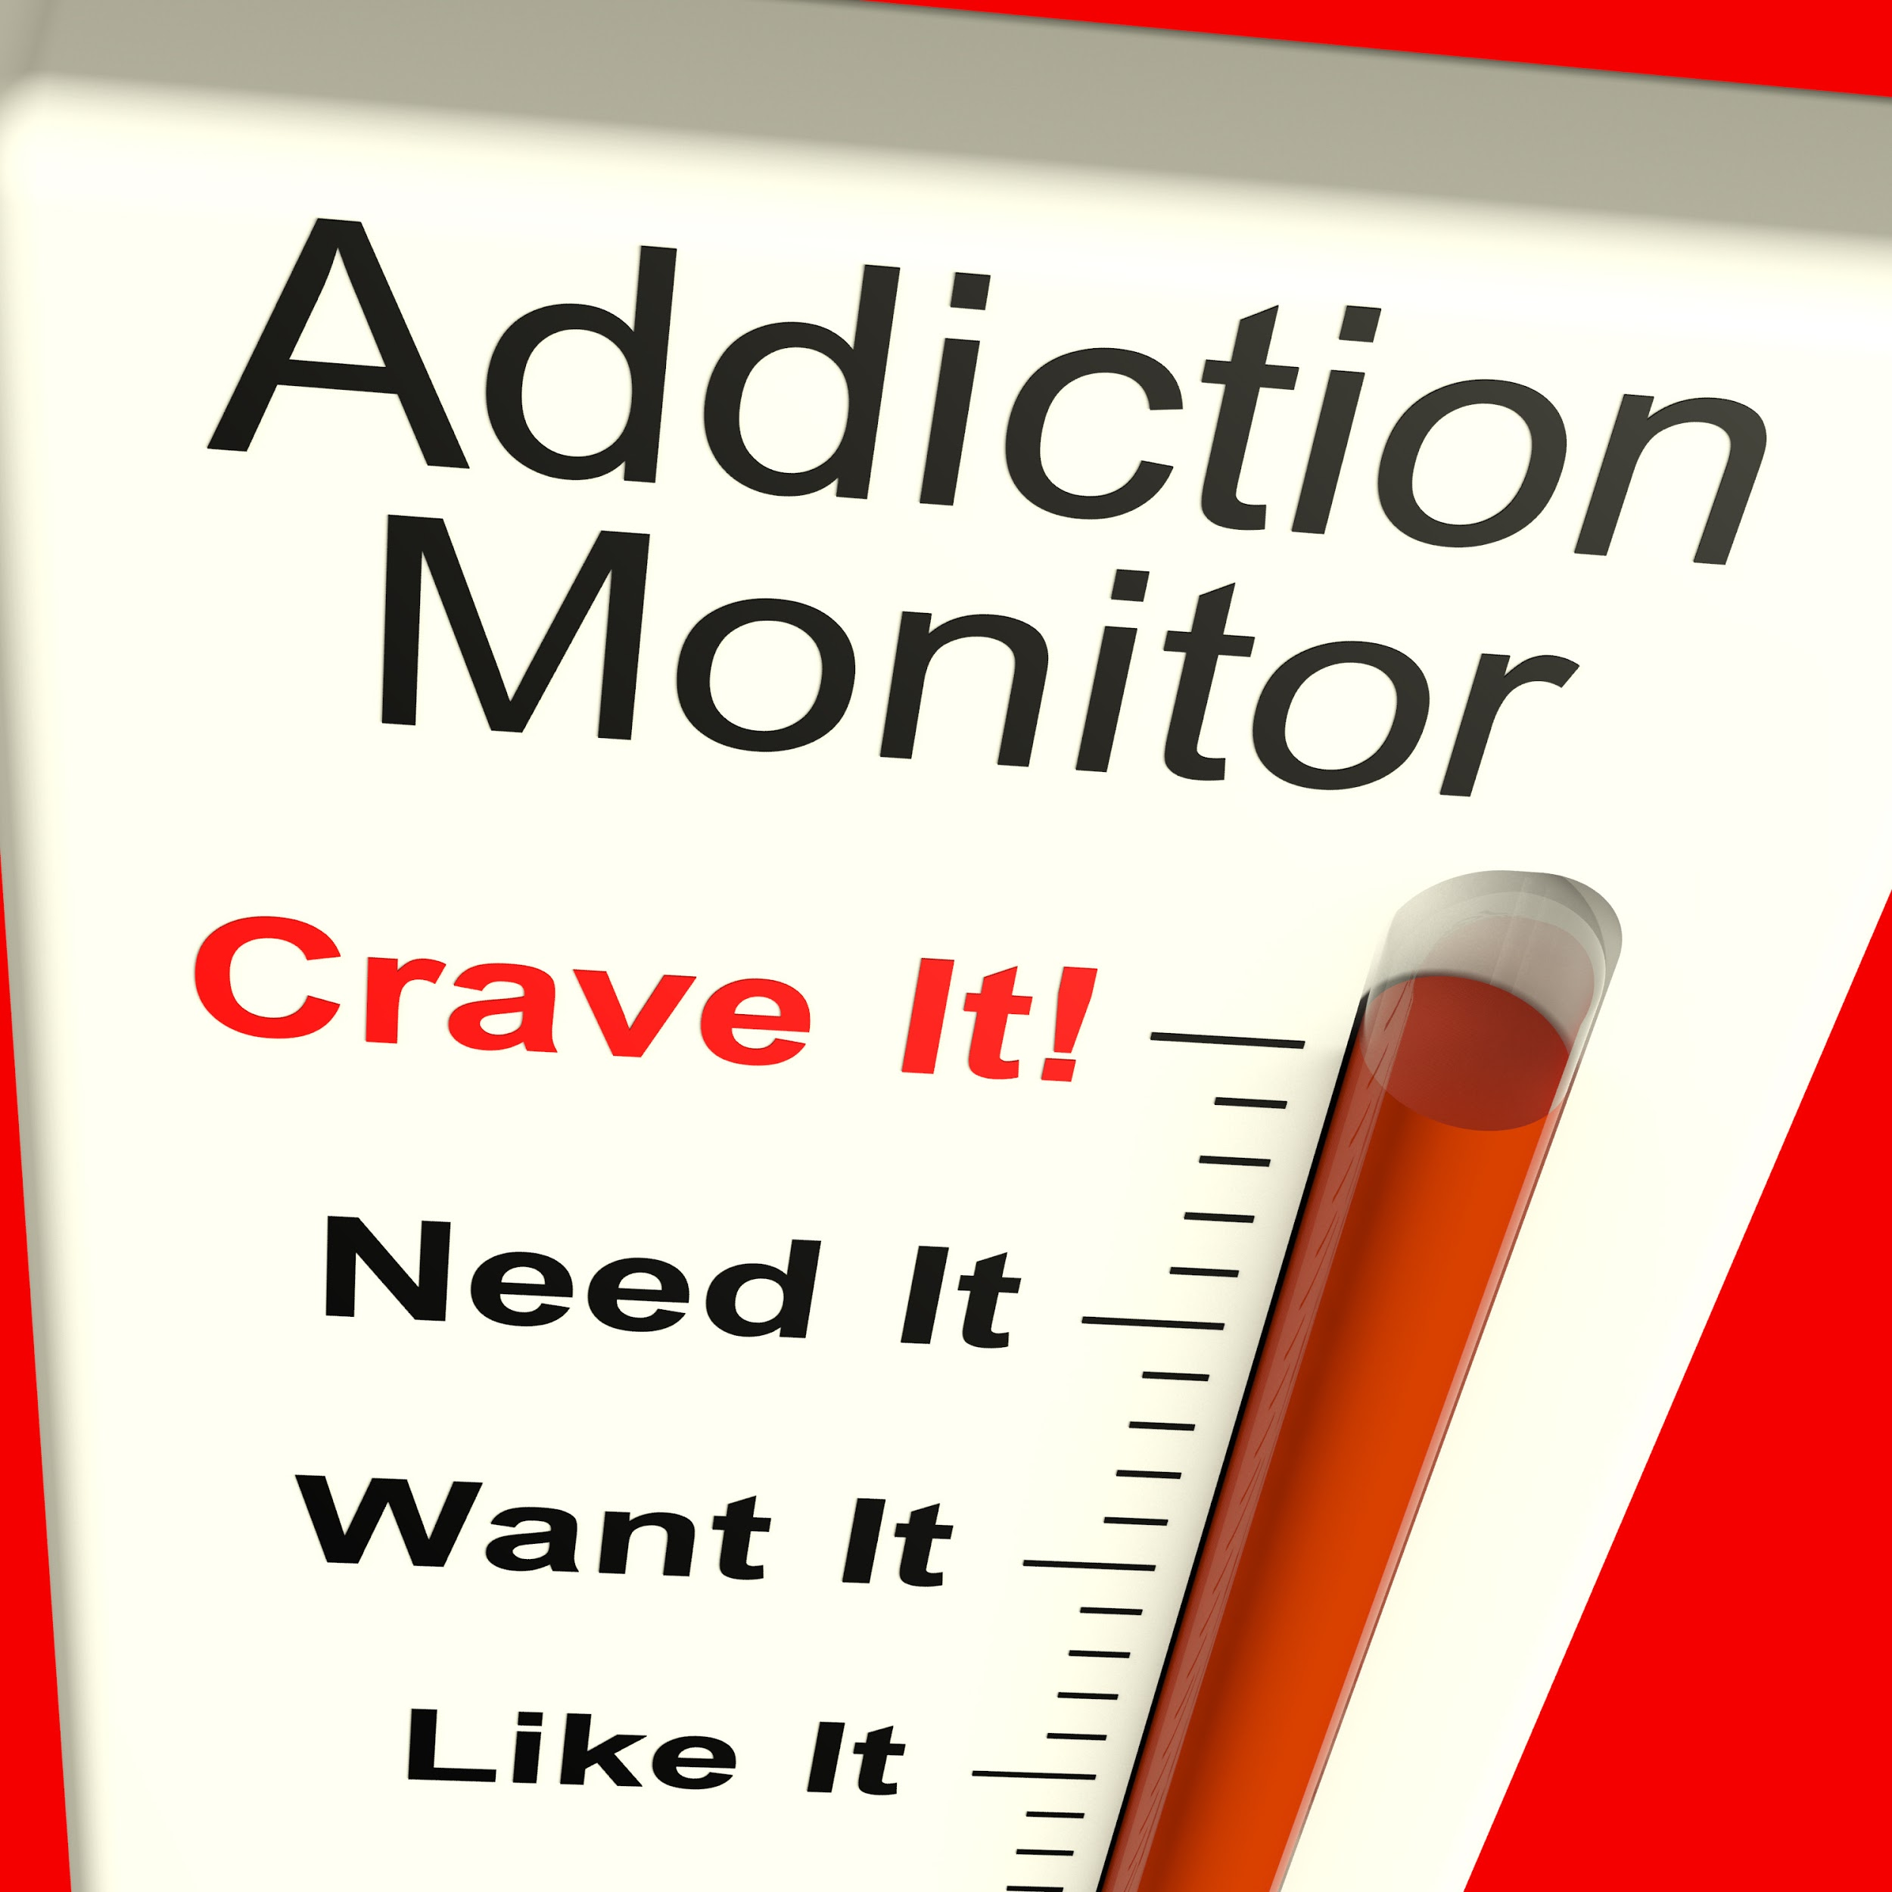
If I am prescribed an opioid, how do I identify abuse?
Do not take more pills than your doctor specifies, or more often. Do not save pills for later use. To protect others from addiction, do not give them to friends or family. Dispose of unused pills safely.
Signs of abuse including the following: Starting to take more than prescribed and/or more frequently than prescribed, beginning to mix with other substances for increased effect, or beginning to take medications for alternatives to pain (e.g. increased pleasure, sedation, or improvement in mood).
Talk to your doctor immediately if you or a family member show signs of addiction or dependence. Early detection and intervention can help stop the destructive cycle of addiction before it becomes too powerful to resist. Talking to an addiction counseling organization is another option.

Slide 16

Tapering Off of Medication(s)
IMPORTANT NOTE: Talk to your doctor about effectively tapering. DO NOT attempt to alter your prescription drug plan without consulting with your physician.
The purpose of tapering is to reduce the effects of withdrawal and allow the user to decrease the need for medication slowly without resorting to street drugs as a supplement or replacement. This is a question that should be asked whenever a long-term opioid prescription is given from a health care provider.
Tapering plans should be individualized and should minimize symptoms of opioid withdrawal while maximizing pain treatment with nonpharmacologic therapies and nonopioid medications. In general:
Go slow - A decrease of 10% per month is a reasonable starting point if patients have taken opioids for more than a year. A decrease of 10% per week may work for patients who have taken opioids for a shorter time (weeks to months).
Discuss the increased risk for overdose if patients quickly return to a previously prescribed higher dose.

Slide 17

Proper Disposal of Medications (FDA.gov)
FDA Flush List: Medicines recommended for disposal by flushing should only be flushed when take back options are not readily available. Medicines on this flush list may be especially harmful and, in some cases, fatal with just one dose if they are used by someone other than the person for whom they were prescribed. An example of such a drug is the fentanyl patch, which is an opioid.
Immediately flushing these types of medicines down the toilet helps keep children, pets, and other individuals safe by making sure these powerful and potentially dangerous drugs are not accidentally ingested, touched, or misused.
The FDA flush list tells you which old, unwanted, expired, or unused medicines to immediately flush only when take back options are not readily available.
FDA believes that the known risk of harm, including death, to humans from accidental exposure to the medicines listed above, especially potent opioid medicines, far outweighs any potential risk to humans or the environment from flushing these medicines. FDA will continue to conduct risk assessments as a part of our larger activities related to the safe use of medicines.
For disposal information, specific to another medication you are taking please visit Drugs@FDA. Once there, type in the medication name and click on search. Then click on the label section for that specific medication. Select the most recent label and search for the term “disposal.”
Flushing medications can have a negative impact on the environment. Only approved medications should be flushed as a last resort if no take back sites are available.

Slide 18
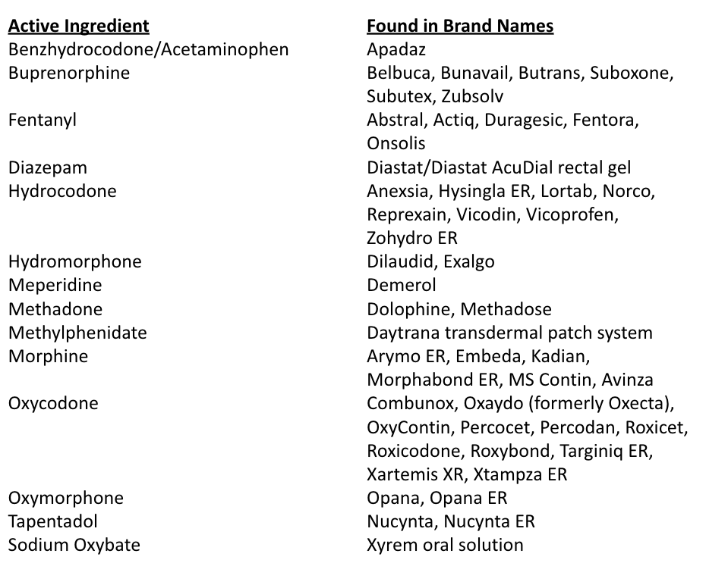


List of Medicines Recommended for Disposal by Flushing
This list from the U.S. Food and Drug Administration (FDA) tells you some medications that are able to be flushed when they are no longer needed.
Flushing should only be used if there are no disposal sites in the area and there is a risk for accidental ingestion. Numerous government organizations warn of the potential impact flushing medications can have on the environment.

Slide 19

Medicines Not Recommended for Disposal by Flushing
For medications not found on the flushable list, follow the following steps before trashing them.
If no drug take back sites, locations, or programs are available in your area, and there are no specific disposal instructions (such as flushing) in the medication guide or package insert, you can follow these simple steps to dispose of most medicines in your trash at home:
Mix medicines (liquid or pills; do not crush tablets or capsules) with an unappealing substance such as dirt, cat litter, or used coffee grounds.
Place the mixture in a container, such as a sealed plastic bag.
Dispose of the container in your trash at home.
Delete all personal information on the prescription label of empty medicine bottles or medicine packaging, then trash or recycle the empty bottle or packaging.
If a medication is not on the flushable list provided by the FDA please follow the guidelines above for proper disposal.

Slide 20
Permanent Collection Locations and Sites
Some facilities and business are registered with the U.S. Drug Enforcement Administration (DEA) to collect old, unused, unneeded, or expired medicines. These authorized drug collection locations safely and securely gather and dispose of pharmaceuticals containing controlled substances, as well as other medicines.
In your community, such authorized collection locations may be in retail pharmacies, hospital or clinic pharmacies, and law enforcement agencies/facilities. Some authorized collectors may also offer mail back programs or collection receptacles (drop off boxes) to assist you in safely disposing of your unused medicines.
Lastly, you can go to Google Maps and type in "drug disposal near me" or "medication disposal near me" to find your nearest drug disposal site.
*Find an authorized drug collection site near you or call the DEA Diversion Control Division Registration Call Center at 1-800-882-9539 for more information.
Periodic Events
The U.S. Drug Enforcement Administration (DEA) periodically hosts National Prescription Drug Take Back events. During these Drug Take Back Days, temporary drug collection sites are set up in communities nationwide for safe disposal of prescription drugs.
Local law enforcement agencies may also sponsor medicine take back events in your community. You can also contact your local waste management authorities to learn about events in your area.

Slide 21
Additional Considerations of Prescription Medications:
Consult - Coordinate with specialists and treatment experts as needed—especially for patients at high risk of harm, such as pregnant women or patients with an opioid use disorder.
Use extra caution during pregnancy due to possible risk to the pregnant patient, and to the fetus if the patient goes into withdrawal.
Support - Make sure patients receive appropriate psychosocial support. If needed, work with mental health providers, arrange for treatment of opioid use disorder, and offer naloxone for overdose prevention.
Watch for signs of anxiety, depression, and opioid use disorder during the taper and offer support or referral as needed.
Encourage - Patient collaboration and buy-in are important to successful tapering. Tell patients that improved function and decreased pain after a taper can be expected, even though pain might initially get worse.
Tell patients “I know you can do this” or “I’ll stick by you through this.”
Considerations
Once the lowest available dose is reached, the interval between doses can be extended. If discontinuing opioids, they may be stopped when taken less than once a day.
Weigh the benefits and risks of opioids. Use clinical judgment and patient information to make decisions about whether to continue at the current dosage, taper and continue at a lower dosage, or taper and discontinue opioid therapy.
Avoid abrupt tapering or sudden discontinuation of opioids.
Adjust the rate and duration of the taper according to the patient’s response.
Don’t reverse the taper; however, the rate may be slowed or paused while monitoring and managing withdrawal symptoms.

Slide 22
Notes:

Slide 23
References:
A Nation in Crisis: A Health Education Approach to Preventing Opioid Misuse and Addiction - Society for Public Health Education. (n.d.). Retrieved February 4, 2020, from https://www.sophe.org/resources/a-nation-in-crisis-a-health-education-approach-to-preventing-opioid-misuse-and-addiction/
The National Academy
ies of Sciences Engineering Medicine. (June 29, 2011). Retrieved from
http://www.nationalacademies.org/hmd/Reports/2011/Relieving-Pain-in-America-A-Blueprint-for-Transforming-Prevention-Care-Education-Research.aspx
Talking with Your Doctor about Prescription Opioid Painkillers. (n.d.). Retrieved from
https://www.pbs.org/wned/opioid-epidemic/resources/talking-your-doctor-about-prescription-painkillers/
Safe Disposal of Medicines. (n.d.). Retrieved from
https://www.fda.gov/drugs/ensuring-safe-use-medicine/safe-disposal-medicines
Disposal of Unused Medicines: What You Should Know. (n.d.). Retrieved from
https://www.fda.gov/drugs/safe-disposal-medicines/disposal-unused-medicines-what-you-should-know
Miech, R., Johnston, L., O’Malley, P. M., Keyes, K. M., & Heard, K. (2015, November 1).
Prescription Opioids in Adolescence and Future Opioid Misuse. Retrieved February 7, 2020, from https://pediatrics.aappublications.org/content/136/5/e1169.abstrac
McCabe, S. E., Teter, C. J., & Boyd, C. J. (2006). Medical use, illicit use and diversion of prescription stimulant medication. Journal of Psychoactive Drugs, 38(1), 43 – 56.
National Institute on Drug Abuse. (2019, May 11). Mental Health. Retrieved March 30, 2020, from https://www.drugabuse.gov/related-topics/mental-health
(n.d.). Retrieved April 1, 2020, from http://www.nationalacademies.org/hmd/Reports/2011/Relieving-Pain-in-America-A-Blueprint-for-Transforming-Prevention-Care-Education-Research.asp
(n.d.). Retrieved April 1, 2020, from http://www.nationalacademies.org/hmd/Reports/2011/Relieving-Pain-in-America-A-Blueprint-for-Transforming-Prevention-Care-Education-Research.aspx
Nicol, A. L., Hurley, R. W., & Benzon, H. T. (2017). Alternatives to Opioids in the Pharmacologic Management of Chronic Pain Syndromes: A Narrative Review of Randomized, Controlled, and Blinded Clinical Trials. Anesthesia and analgesia, 125(5), 1682–1703. https://doi.org/10.1213/ANE.0000000000002426

Slide 24

THE OFFICE OF WORKFORCE ENGAGEMENT
www.CommonHealth.gov
Virginia Department of Human Resources
101 N 14th Street Richmond VA 23219

